Slide 1
Distributed Deep learning
Ahmad Sheikhzada Computational Scientist E: jus2yw@virginia.edu
Jacalyn Huband Senior Computational Scientist E: jmh5ad@virginia.edu

Slide 2
Why this workshop?
Deep learning (DL) is a powerful tool transforming scientific workflow
DL training is computationally intensive, therefore it is well suited to HPC systems
Effective use of UVA HPC resources can greatly accelerate your DL workflows
When to use a GPU?
How to optimize your single-GPU code?
How to convert single-GPU code to Multi-GPU code in different frameworks and run it on UVA HPC?

Slide 3
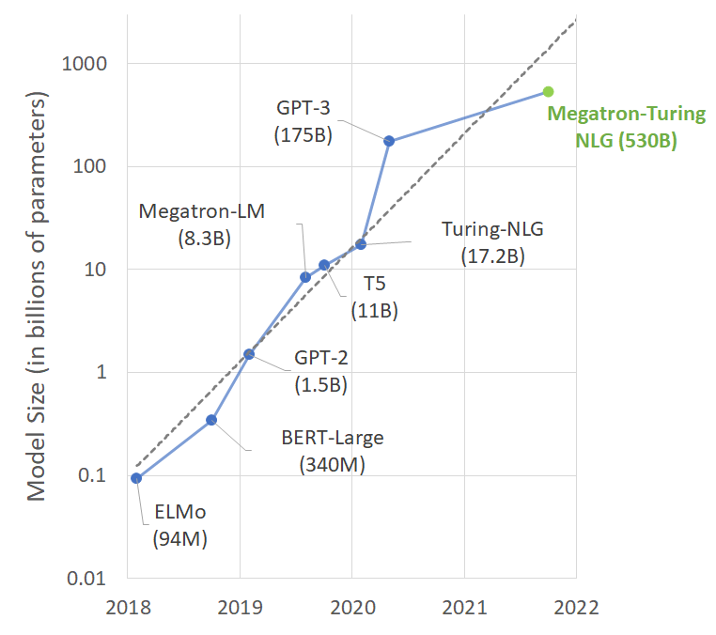
Complex tasks, big models => more compute
HPC systems can help meet this demand
Specialized hardware: GPUs and more
Credit: NVIDIA

Slide 4
Topics
Overview of Deep Learning
Example: Convolutional Neural Network
Introduction to GPUs and GPU Computing
Tensorflow/Keras
Single-GPU
PyTorch
Single-GPU
Distributed Training
TF Multi-GPU
PT Multi-GPU
PT Lightning Multi-GPU
Remarks

Slide 5
Overview of Machine learning/Deep learning

Slide 6

https://www.edureka.co/blog/ai-vs-machine-learning-vs-deep-learning/

Slide 7
What is machine learning?
A branch of artificial intelligence where computers learn from data and adapt the computational models to enhance performance.
A method of analysis that allows computers to reveal information within data.
The “learning” is not the type of learning that you and I do.
It is a systematic approach to finding an appropriate data transformation from inputs to output.

Slide 8
Why machine learning?
Computers can sort through data faster than humans can.
Computers can identify patterns quickly and use these patterns for predictions or classifications.
Machine learning can handle noisy data – it doesn’t find a perfect answer, but rather a “really good” answer.

Slide 9
Problems that ML can solve
Regression techniques
Determines a mathematical model for the relationship among features or attributes so that an outcome can be predicted.
Results can be any value within a possible range (e.g., what will the average Earth temperature be in 2050?)
Classification problem
Identifies a combination of attributes that best fits a class or category so that an object can be classified.
Results can be from a list of known possibilities (e.g., is the tumor benign or malignant?)
Note: Examples included here are all of classification type problems.

Slide 10
Types of Machine Learning. . .
Supervised Learning:
A data set exists where the samples can be categorized into two or more classifications.
The computer uses the data set to learn how to predict the classification of an unknown sample.
Examples include Decision Trees and Deep Learning
Unsupervised Learning:
The collected data has no known classification or pattern.
The computer must identify the groups or hidden structures within the data.
Examples include Dendograms, K-means clustering, Self-organizing Maps
Reinforcement Learning:
Computer learns from positive or negative feedback
Example includes Swarm intelligence
Note: Examples included here are all supervised learning.

Slide 11
Data for Machine Learning
For many Machine Learning algorithms, the data are expected to be in a table format, where:
each row represents an object, and
each column has the measurements for a specific attribute or feature of the object
For supervised learning, the classifications of the objects must be known.
The data with known classifications are divided into a training set and a testing set.
The data are used to develop a model.
The training data are submitted to an algorithm that will fit a model to the data.
The test data are submitted to the model to produce predicted classifications and determine the accuracy of the model.
Finally, the model can be used to predict classifications for “unknown” data.

Slide 12
Ideas behind Machine Learning
The algorithm determines the best mathematical model for the code
However, you still need to provide a “framework” for the algorithm.
The framework provides the algorithm with tools for performing the learning
Data Measurements
Machine Learning Algorithm
Model defining the relationship between the input and the output
Label or Classification

Slide 13
DL vs ML
DL is subset of ML that differentiates itself from ML algorithms based on the methods (neural networks) it uses to solve problems.
Any deep learning algorithm would reiterate and perform a task repeatedly, improving a bit every time, in order to improve the outcome.
DL program builds the feature set by itself without supervision and domain expertise. Unsupervised learning is not only faster, but it is usually more accurate.
Needs access to immense amounts of data and compute power
Takes much longer to train but much faster to run tests
ML algorithms have superior interpretability and are favorable for small amounts of data.
ML works only with sets of structured and semi-structured data, while deep learning works with both structured and unstructured data

Slide 14
Some Limitations and Challenges
DL models learn through observations. Outcome is not ”generalizable” if data was small or its scope was limited.
If a model trains on data that contains biases, the model will reproduce those biases in its predictions.
If the learning rate is too high, then the model will converge too quickly, producing a less-than-optimal solution. If the rate is too low, then the process may get stuck, and it will be even harder to reach a solution.
Large amount of data and parameters

Slide 15
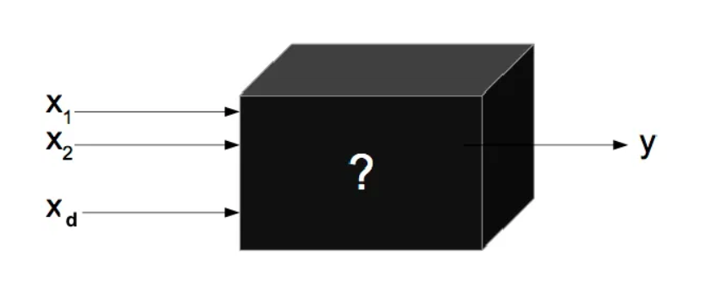
What is deep learning?
A branch of artificial intelligence where programs use multiple layers of neural networks to transform a set of input values to output values
Deep Neural Network

Slide 16
How does it learn?
During the training or “fitting” process, you feed into the Deep Learning algorithm a set of measurements/features and the expected outcome (e.g., a label or classification).
The algorithm determines the best weights and biases for the data.
Data Measurements
Deep Learning Algorithm
Model defining the relationship between the input and the output
Label or Classification

Slide 17

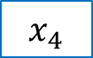
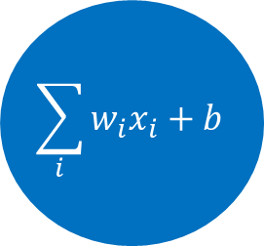





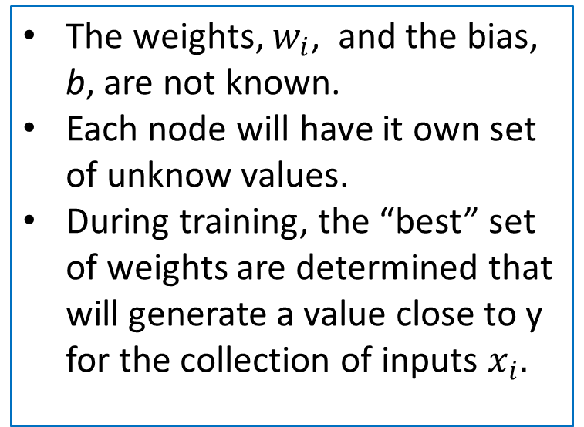

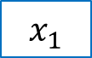


A Peek at a Node
Each “node” in the neural network performs a set of computations
The weights, $w_{i}$, and the bias, b, are not known.
Each node will have it own set of unknow values.
During training, the “best” set of weights are determined that will generate a value close to y for the collection of inputs $x_{i}.$
$$x_{1}$$
$$x_{2}$$
$$w_{1}$$
$$\sum_{i}{w_{i}x_{i}+b}$$
$$w_{2}$$
$$x_{3}$$
Activation function
$$w_{3}$$
$$\hat{y}$$
$$x_{4}$$
$$w_{4}$$
$$x_{5}$$
$$w_{5}$$

Slide 18

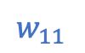
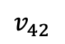
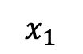
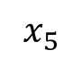

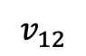

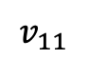
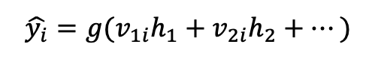
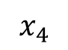

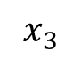
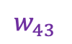

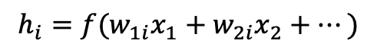
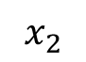

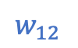
A Network of Neurons (Multi-layer Perceptron)
Input layer
Hidden layer
Output layer
Different computations with different weights can be performed to produce different outputs.
This is called a feedforward network – all values progress from the input to the output.
A neural network has a single hidden layer
A network with two or more hidden layers is called a “deep neural network”.
$$w_{11}$$
$$h_{1}$$
$$v_{11}$$
$$x_{1}$$
$$w_{12}$$
$$v_{12}$$
$$\hat{y_{1}}$$
$$x_{2}$$
.
.
.
$$h_{2}$$
.
.
.
$$x_{3}$$
$$h_{3}$$
$$x_{4}$$
$$w_{43}$$
$$\hat{y_{2}}$$
.
.
$$v_{42}$$
$$x_{5}$$
$$h_{4}$$
$$h_{i}=f(w_{1i}x_{1}+w_{2i}x_{2}+…)$$
$$\hat{y_{i}}=g(v_{1i}h_{1}+v_{2i}h_{2}+…)$$

Slide 19
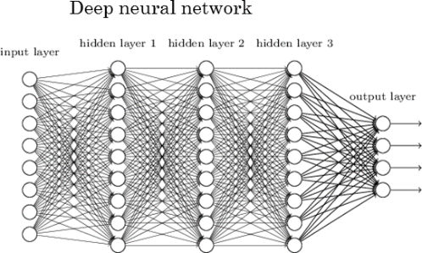
Deep Learning Neural Network Multilayer Perceptron/ Fully Connected NN
Deep Neural Network
Image borrowed from:
http://www.kdnuggets.com/2017/05/deep-learning-big-deal.html

Slide 20
How does the machine learn?
Start with a random guess for the weights and biases.
The output values or “predicted” values of the network can be compared with the expected results/categories/labels.
Another function, called a “loss” or “cost” function can be used to determine the overall error of the model.
That error can be used to work backwards through the network and tweak the weights/biases.
This step is called backward propagation.

Slide 21
Overview of the Learning Process
Random guesses for the weights
Input Values
Run the data through the nodes to compute the output values
Predicted output
Compute the loss function & metrics
Tweak the weights
Output Values
Training Loop
Model that predicts output for given input

Slide 22
Overview of Learning Process
Random guesses for the weights
Input Values
Run the data through the nodes to compute the output values
Predicted output
Compute the loss function & metrics
Tweak the weights
Output Values
Training Loop
We provide the inputs and outputs.
Model that predicts output for given input

Slide 23
Overview of Learning Process
Random guesses for the weights
Input Values
Run the data through the nodes to compute the output values
Predicted output
Compute the loss function & metrics
Tweak the weights
Output Values
Training Loop
We design the model, the layers, the number of nodes, and the activation functions.
Model that predicts output for given input

Slide 24
Overview of Learning Process
Random guesses for the weights
We tell the algorithm which loss function to use.
Input Values
Run the data through the nodes to compute the output values
Predicted output
Compute the loss function & metrics
Tweak the weights
Output Values
Training Loop
Model that predicts output for given input

Slide 25
Overview of Learning Process
Random guesses for the weights
We tell the algorithm the method for tweaking the weights
Input Values
Run the data through the nodes to compute the output values
Predicted output
Compute the loss function & metrics
Tweak the weights
Output Values
Training Loop
Model that predicts output for given input

Slide 26
Overview of Learning Process
Random guesses for the weights
Input Values
Run the data through the nodes to compute the output values
Predicted output
Compute the loss function & metrics
Tweak the weights
Output Values
Training Loop
We tell the algorithm how many times it should loop.
Model that predicts output for given input

Slide 27
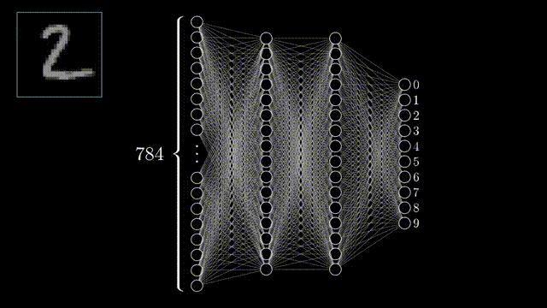
DNN Example
Animation adapted from: youtube.com/watch?v=aircAruvnKk&feature

Slide 28
Common Types DNNs
Feed-Forward NN
Consist of an input layer, an output layer and many hidden layers that are fully connected, and can be used to build speech-recognition, image-recognition, and machine-translation software.
Recurrent NN
RNNs are commonly used for image captioning, time-series analysis, natural-language processing, machine translation, etc.
Convolution NN
Consist of multiple layers and are mainly used for image processing and object detection.
And many more such as RBFNs, GANs, Modular NN, etc.

Slide 29
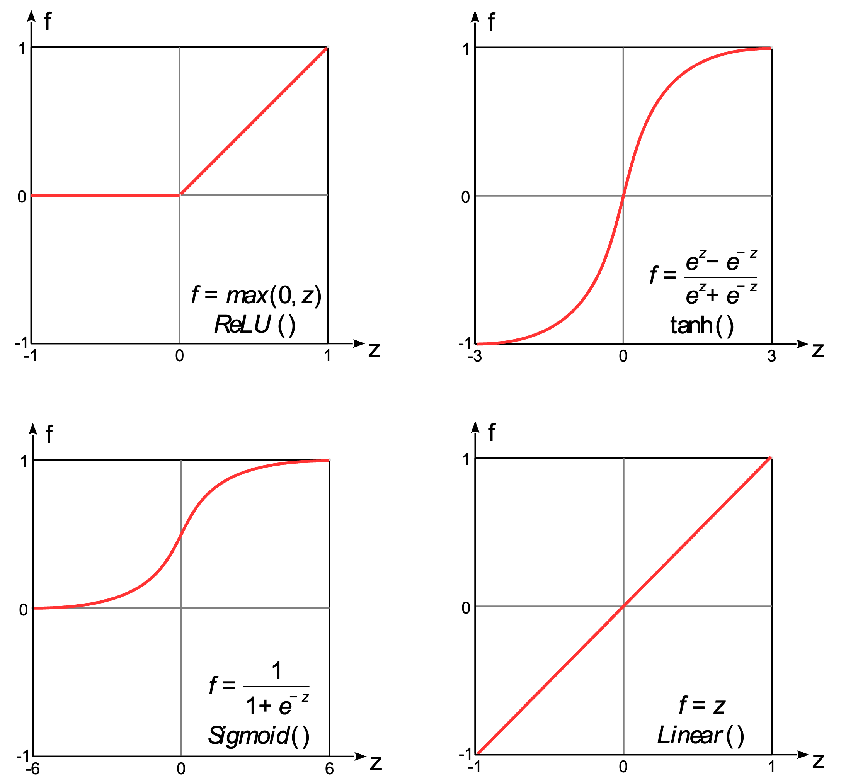
Activation Function
Activation function introduces nonlinearity into the model.
Can choose different activation functions for each layer.
Examples include ReLU, Sigmoid(binary classification), and Softmax(multiclass classification).
A complete list is available at
https://www.tensorflow.org/api_docs/python/tf/keras/activations
https://pytorch.org/docs/stable/nn.html#non-linear-activations-weighted-sum-nonlinearity

Slide 30

Loss Function
Tells us how good our model is at relating the input to the output.
A function that will be optimized to improve the performance of the model.
The cost value is the difference between the neural nets predicted output and the actual output from a set of labeled training data.
The choice of loss function is based on the task.
Examples include
Classification: BCELoss (Binary Cross Entropy) and Cross Entropy Loss.
Regression: Mean Squared Error (MSE)
A complete list is available at
https://pytorch.org/docs/stable/nn.html#loss-functions and https://www.tensorflow.org/api_docs/python/tf/keras/losses

Slide 31
Optimizer functions
The function for tweaking/adjusting the parameters during training so that the best weights and biases are efficiently reached.
Examples include SGD, Adam, and RMSprop.
A complete list is available at https://pytorch.org/docs/stable/optim.html?highlight=optimizer#torch.optim.Optimizer
and
https://www.tensorflow.org/api_docs/python/tf/keras/optimizers

Slide 32
Metrics
A formula for measuring the accuracy of the model.
Examples include Accuracy and MeanSquaredError.
A complete list is available at https://keras.io/api/metrics.

Slide 33
Epochs and Batch Size
An epoch is one pass through the training loop over all of the training data.
During each epoch, training generally occurs on batches of data at a time instead of on the full dataset all at once. The number of samples in each batch is called the batch size.
Smaller batch sizes
guarantee that a batch can fit on the GPU
allow the model to generalize well, but increase training time

Slide 34
Training, Validation, and Test Sets
Training set: inputs/outputs used during NN training.
Validation set:
used during training to see how well the network is generalizing to unseen data, but the NN parameters are not affected by these inputs/outputs.
Inputs are sent to the NN during each epoch and the loss/metrics are calculated on this set of inputs/outputs.
If NN performance on the validation set is poor, this is a sign that the NN hyperparametes (e.g. number of layers, number of neurons, etc.) need to be adjusted.
Test set: Unseen data used to measure the performance of the NN.

Slide 35
Callbacks - Early Stopping and Checkpointing
Generally, we set the number of epochs for a model to train.
However, if model performance on the validation set is not improving, it would be nice if training could end early to avoid overfitting.
Callback: inputs to the model.fit function, dictate actions to take during training or inference
EarlyStopping: callback that stops the training process once model performance on the validation set no longer improves.
ModelCheckpoint: callback that saves the best model, e.g., the model with the lowest loss on the validation set. This is probably not the model produced at the last training epoch.

Slide 36
Dropout Regularization
Can be used on input or hidden layers
During each training epoch a percentage of random neurons in the layer are dropped out.
Prevents overfitting
Neurons are only dropped out during training, not inference.

Slide 37
Example: Convolutional Neural Networks

Slide 38
What are Convolutional Neural Networks?
Originally, convolutional neural networks (CNNs) were a technique for analyzing images.
Applications have expanded to include analysis of text, video, and audio.

Slide 39
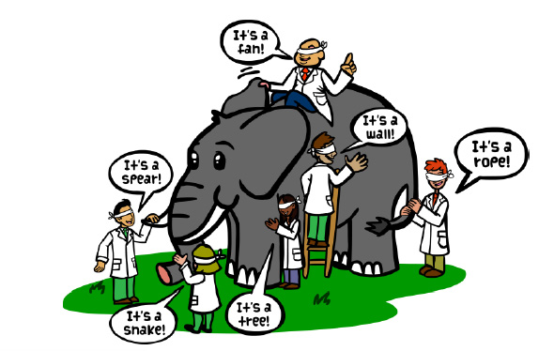
The Idea behind CNN
Recall the old joke about the blind-folded scientists trying to identify an elephant.
A CNN works in a similar way. It breaks an image down into smaller parts and tests whether these parts match known parts.
It also needs to check if specific parts are within certain proximities.
For example, the tusks are near the trunk and not near the tail.
Image borrowed from https://tekrighter.wordpress.com/2014/03/13/metabolomics-elephants-and-blind-men/

Slide 40
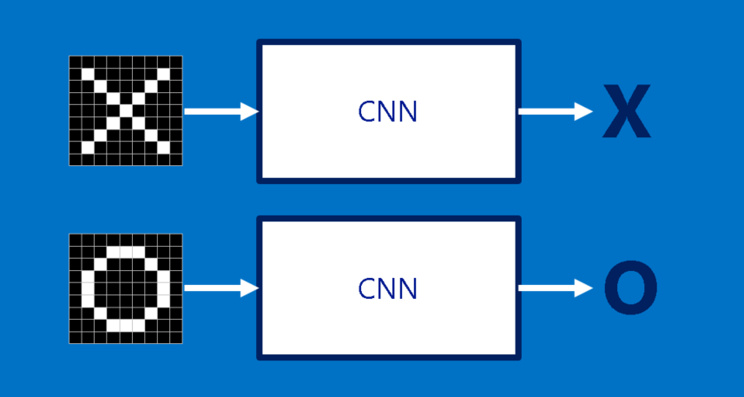
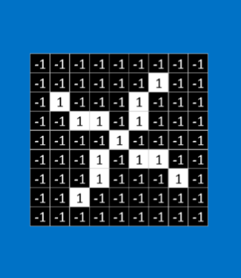
Is the image on the left most like an X or an O?
Images borrowed from
http://brohrer.github.io/how_convolutional_neural_networks_work.html

Slide 41
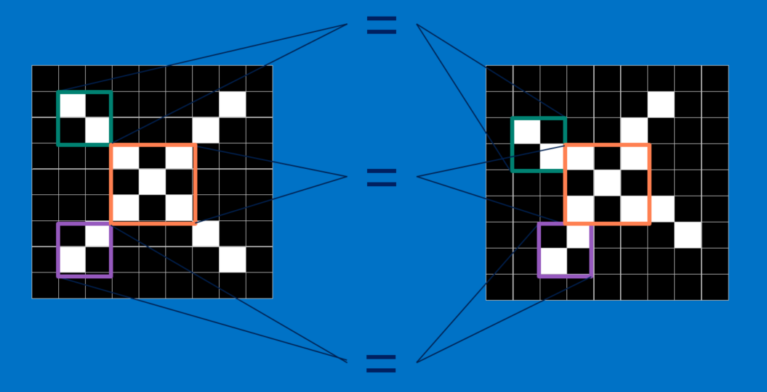
What features are in common?

Slide 42
Building Blocks of CNN
CNN performs a combination of layers
Convolution Layer
Compares a feature with all subsets of the image
Creates a map showing where the comparable features occur
Rectified Linear Units (ReLU) Layer
Goes through the features maps and replaces negative values with 0
Pooling Layer
Reduces the size of the rectified feature maps by taking the maximum value of a subset
And ends with a final layer
Classification (Fully-connected layer) layer
Combines the specific features to determine the classification of the image

Slide 43
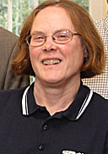
Steps
28*28
32@26*26
32
32@13*13
32 feature maps
filter size 3
Pooling
Filter 2*2
.
.
.
Convolution Rectified Linear Pooling
These layer can be repeated multiple times.
The final layer converts the final feature map to the classification.
{
Notes:
Here we consider a gray scale image with only one channel and 28*28 pixels.
(Width-Filtersize+2*Padding)/Stride +1 = (28-3+2*0)/1+1=26
Dropout layers does not change the dimensions of the matrix, just zeroes out randomly some weights.

Slide 44
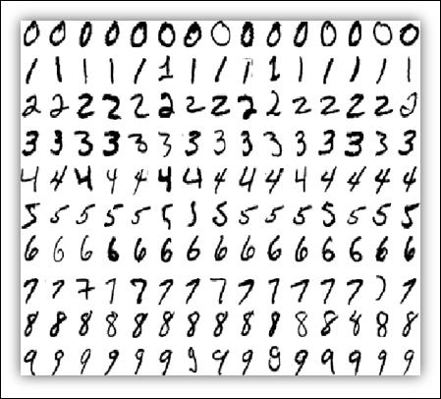
Example: MNIST Data
The MNIST data set is a collection of hand-written digits (e.g., 0 – 9).
Each digit is captured as an image with 28x28 pixels.
The data set is already partitioned into a training set (60,000 images) and a test set (10,000 images).
The tensorflow and PyTorch packages have tools for reading in the MNIST datasets.
More details on the data are available at http://yann.lecun.com/exdb/mnist/
Image borrowed from
Getting Started with TensorFlow by Giancarlo Zaccone

Slide 45
What about GPUs?
Because the training process involves hundreds of thousands of computations, we need a form of parallelization to speed up the process.
GPUs provide the needed parallelization.

Slide 46
GPU

Slide 47
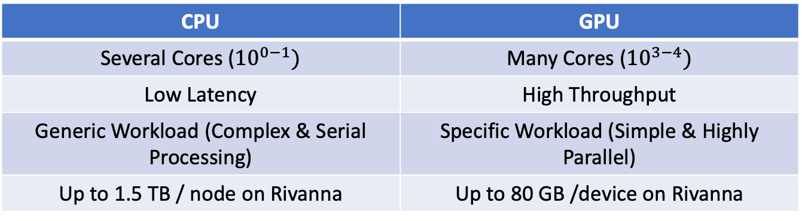
GPU: Overview
Graphics Processing Units (GPUs), originally developed for accelerating graphics rendering, can dramatically speed up any simple but highly parallel computational processes (General Purpose GPU).
GPU vs CPU
Integrated vs Discrete
Integrated mostly for graphics rendering and gaming
Dedicated GPUs designed for intensive computations
CPU | GPU
Several Cores (${10}^{0−1})$ | Many Cores (${10}^{3−4})$
Low Latency | High Throughput
Generic Workload (Complex & Serial Processing) | Specific Workload (Simple & Highly Parallel)
Up to 1.5 TB / node on Rivanna | Up to 80 GB /device on Rivanna
Notes:
Back up slide

Slide 48
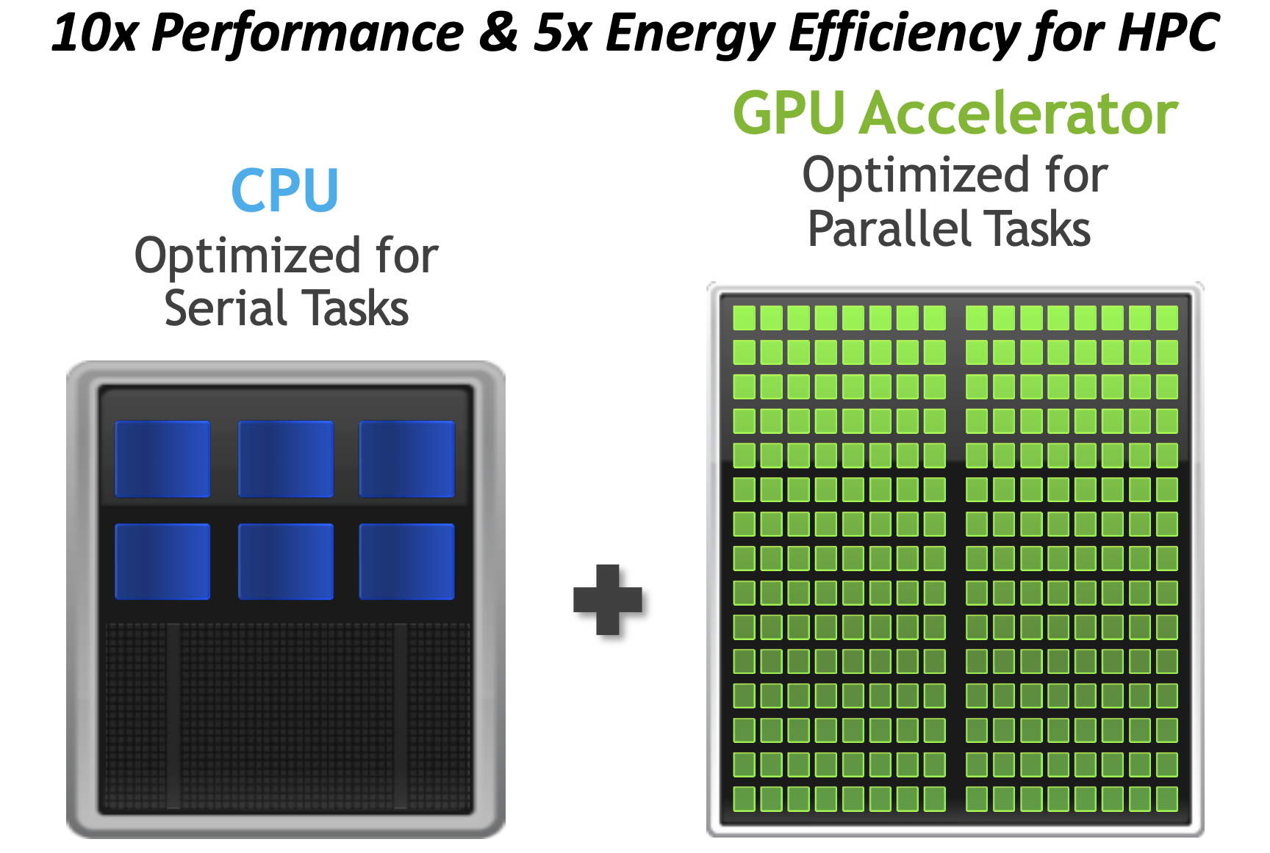
Credit: NVIDIA
Notes:
https://developer.nvidia.com/blog/nvidia-grace-hopper-superchip-architecture-in-depth/
Like a CPU, a GPU has a hierarchical structure with respect to both the execution units and memory. A warp is a unit of 32 threads. NVIDIA GPUs impose a limit of 1024 threads per block. Some integral number of warps are grouped into a streaming multiprocessor (SM). There are tens of SMs per GPU. Each thread has its own memory. There is limited shared memory between a block of threads. And, finally, there is the global memory which is accessible to each grid or collection of blocks.

Slide 49
GPU: Overview
Vendors & Types
NVIDIA, AMD, Intel
Datacenter : K80, P100, V100, A40, A100, H100
Workstations: A6000, Quadro
Gaming: GeForce RTX 20xx, 30xx, 40xx
CUDA vs OpenCL (Make GPUs programmable)
CUDA is parallel computation platform, developed by NVIDIA, allows software to run on both CPU and GPU
OpenCL: More general parallel computing platform, developed by Apple, allows software to access CPUs, GPUs, FPGAs etc.
Both are compatible with Python, but most GPU-enabled Python libraries will only work with NVIDIA GPUs.

Slide 50
GPU Computing
For certain workloads like image processing, training artificial neural networks and solving differential equations, a GPU-enabled code can vastly outperform a CPU code. Algorithms that require lots of logic such as "if" statements tend to perform better on the CPU.
Steps required to execute a function (kernel) on a GPU:
copy the input data from the CPU memory to the GPU memory
load and execute the GPU kernel on the GPU
copy the results from the GPU memory to CPU memory
Depending on the DL framework, some of these steps may be automatically done.
Recently, manufacturers have incorporated specialized units on the GPU called Tensor Cores (NVIDIA) or Matrix Cores (AMD) to perform certain operations in less than single precision.
Notes:
This is particularly beneficial to researchers training artificial neural networks or, more generally, cases where matrix-matrix multiplications and related operations dominate the computation time. Modern GPUs, with or without these specialized units, can be used in conjunction with a CPU to accelerate scientific codes.
https://github.com/PrincetonUniversity/gpu_programming_intro/
GPU accelerated libraries. https://developer.nvidia.com/gpu-accelerated-libraries
As with the CPU, a GPU can perform calculations in single precision (32-bit) faster than in double precision (64-bit).

Slide 51
Computational Graphs
Computational graphs help to break down computations.
For example, the graph for y=(x1+x2)*(x2 - 5) is
x1
a = x1 + x2
The beauty of computational graphs is that they show where computations can be done in parallel.
y = a*b
x2
b = x2 - 5

Slide 52
Why to use GPUs in DL?
Data flows in neural networks can be efficiently implemented by computational graphs. This is the case with popular frameworks like TensorFlow and PyTorch.
With deep learning models, you can have hundreds of thousands of computational graphs.
A GPU can perform a thousand or more of the computational graphs simultaneously. This will speed up your program significantly.
New GPUs have been developed and optimized specifically for deep learning.
All the major deep learning Python libraries (Tensorflow, PyTorch, Keras, Caffe,…) support the use of GPUs and allow users to distribute their code over multiple GPUs.

Slide 53
GPUs in DL …
Scikit-learn does not support GPU processing.
Deep learning acceleration is furthered with Tensor Cores in NVIDIA GPUs.
Tensor Cores accelerate large matrix operations by performing mixed-precision computing.
Accelerates math, Reduces the memory traffic and consumption.
If you’re not using a neural network as your machine learning model you may find that a GPU doesn’t improve the computation time.
If you are using a neural network but it is very small then a GPU will not be any faster than a CPU - in fact, it might even be slower.

Slide 54
GPU Utilization & Profiling
jupyterlab-nvdashboard (GPU Dashboards)
nvidia-smi
only a measure of the fraction of the time that a GPU kernel is running on the GPU. Nothing about how many CUDA cores are being used or how efficiently the GPU kernels have been written.
Line_profiler for any python code (PyTorch and TensorFlow).
Nsight Systems(nsys) for profiling GPU codes. It produces a timeline and can handle MPI but produces a different set of profiling data for each MPI process.
Nsight Compute(ncu) to look closely at the behavior of specific GPU kernels.
Notes:
https://researchcomputing.princeton.edu/support/knowledge-base/gpu-computing
However, for codes used by large communities, one can generally associate GPU utilization with overall GPU efficiency.
Nsys and ncu: More accurate measure of GPU utilization.

Slide 55
GPU Utilization & Profiling
Zero GPU utilization
Is code GPU enabled?
Is software environment properly configured?
Does code spend much time transferring data between CPU and GPU?(e.g. during interactive jobs)
Low GPU utilization:
Misconfigured application scripts.
Using high end GPU for codes that do not have enough work to keep the GPU busy. Using A100 for job that P100 is sufficient.
Training deep learning models while only using a single CPU-core. Codes such as Pytorch and TF show performance benefits when multiple CPU-cores are used for the data loading.
Using too many GPUs for a job. You can find the optimal number of GPUs and CPU-cores by performing a scaling analysis.
Writing output files to slow storage systems instead of scratch or GPFS.
Running a code written to work for a single GPU on multiple GPUs.
Notes:
Make sure the software environment is configured properly.
For hyperparameter tuning consider using a job array. This will allow you to run multiple jobs with one sbatch command. Each job within the array trains the network using a different set of parameters.

Slide 56
Rivanna-NVIDIA DGX BasePOD
18 DGX A100 nodes
8 NVIDIA A100 GPUs.
80 GB GPU memory options.
Dual AMD EPYC™ 7742 CPUs, 128 total cores, 2.25 GHz (base), 3.4 GHz (max boost).
2 TB of system memory.
Two 1.92 TB M.2 NVMe drives for DGX OS, eight 3.84 TB U.2 NVMe drives for storage/cache.
Advanced Features:
NVLink for fast multi-GPU communication
GPUDirect RDMA Peer Memory for fast multi-node multi-GPU communication
GPUDirect Storage with 200 TB IBM ESS3200 (NVMe) SpectrumScale storage array
Ideal Scenarios:
Job needs multiple GPUs on a single node or multi node
Job (single or multi-GPU) is I/O intensive
Job (single or multi-GPU) requires more than 40GB of GPU memory
Notes:
Always try to use the CUDA Toolkit 11.x and cuDNN 8.x since they are needed to take full advantage of the A100
More about GPUDirect – backup slide

Slide 57
GPU access on UVA HPC
General
GPUs available in both interactive and gpu partition, GPU type and number can be specified.
POD nodes
POD nodes are contained in the gpu partition with a specific Slurm constraint.
Slurm script:
#SBATCH -p gpu
#SBATCH --gres=gpu:a100:X # X number of GPUs
#SBATCH -C gpupod
Open OnDemand
--constraint=gpupod

Slide 58
TensorFlow

Slide 59
What is TensorFlow?
A software library, developed by the Google Brain Team.
TensorFlow already has the code to assign the data to the GPUs and do the heavy computational work; we simply have to give it the specifics for our data and model.
Keras is an open-source deep learning library in Python that provides an easy-to-use interface to TensorFlow. Keras is built on top of the TF.
tf.keras is the Keras API integrated into TensorFlow 2
Notes:
https://www.tensorflow.org/guide/mixed_precision

Slide 60
Terminology: Tensors
Tensor: A multi-dimensional array
Example: A sequence of images can be represented as a 4-D array: [image_num, row, col, color_channel]
+ Tensors can be used on a GPU
Px_value[1, 1, 3, 2]=1
Image #0
Image #1

Slide 61
Installation
Installation
Conda
Container (available as module and OOD)
Build from source
TensorFlow will run GPU-enabled operations on the GPU by default. However, more than one GPU requires appropriate changes within the TensorFlow script.
Notes:
conda create -n tf2-gpu tensorflow-gpu -c conda-forge
apptainer exec --nv $CONTAINERDIR/tensorflow-2.13.0.sif python mycode.py
https://www.tensorflow.org/install/source

Slide 62
TF Performance and Profiling
Multithreading should give a substantial speed-up for large input pipelines via tf.data where the ETL takes place on the (multicore) CPU only. Use multiple CPU-cores to prepare the data and keep the GPU busy.
train_dataset = datasets['train'].map(preprocess_data, num_parallel_calls=tf.data.AUTOTUNE)\
.cache()\
.shuffle(SHUFFLE_SIZE)\
.batch(BATCH_SIZE)\
.prefetch(tf.data.AUTOTUNE)
TensorBoard:
It can be used to view your graph, monitor training progress and more. Included in a Conda installation of TensorFlow.
Instructions available on RC website

Slide 63
Profiling
Line_profiler
TF Profiler and debugger-embedded within tensorboard (GPU required).
Nsys and ncu
Notes:
An excellent starting point for profiling any Python script is line_profiler. This will provide high-level profiling data such as the amount of time spent on each line of your script.
https://www.tensorflow.org/tensorboard/tensorboard_profiling_keras
Performance tuning presentation: https://tigress-web.princeton.edu/~jdh4/TensorflowPerformanceOptimization_GTC2021.pdf
TensorRT: an SDK for high-performance deep learning inference. You can either use the container(Link is external) from NVIDIA with Singularity or build from source as described below.

Slide 64
Coding Tensor Flow: General Steps
Import Modules
Read in the data
Divide the data into a training set and a test set.
Preprocess the data
Design the Network Model
Train the model- Compile, Checkpointing, EarlyStopping and Fitting
Apply the model to the test data and display the results
Loading a checkpointed model

Slide 65
Activity: CNN Program
Make sure that you can run the CNN code:
Python
TF_CNN_SingleGPU.ipynb

Slide 66
PyTorch

Slide 67
What is PyTorch?
Another widely-used deep learning platform known for its flexibility and speed.
A software library, developed by Facebook and maintained by Mega AI.
Torch is an open-source project for DL written in C and generally used via the Lua interface. Torch is no longer actively developed but libraries are used in Pytorch.

Slide 68
Overview of PyTorch
Because PyTorch and Tensorflow use some common underlying codes, many of the required functions (e.g., activation, loss, optimizer) will be the same.
Popular library used by academics and researchers.

Slide 69
Pytorch
Installation
Conda
Container (NGC)
Building from source
Performance and Utilization:
Use DataLoader and try increasing the value of cpus-per-task in tandem with num_workers to prepare the data and keep the GPU busy. This was shown to dramatically increase the GPU utilization.
Mixed precision training requires either the V100 or A100 GPU and is included in PyTorch as torch.cuda.amp. PyTorch will perform FP32 matrix multiplications using TF32 by default.
gpustat, Line_profiler, nvprof or nsys (if on GPU)
TensorBoard is a useful tool for tracking the training process of a PyTorch model. Available through conda and container version.
Notes:
conda create --name torch-env pytorch torchvision pytorch-cuda=12.1 -c pytorch –c nvidia
https://github.com/pytorch/pytorch#from-source
./nvprof python mnist_classify.py --epochs=3
Automatic Mixed Precision: https://pytorch.org/docs/stable/amp.html
Performance Tuning Guide: https://pytorch.org/tutorials/recipes/recipes/tuning_guide.html
pytorch performance tuning: https://tigress-web.princeton.edu/~jdh4/PyTorchPerformanceTuningGuide_GTC2021.pdf
Writing a custom dataloader: https://www.youtube.com/watch?v=PXOzkkB5eH0
External datal loading libraries: https://github.com/libffcv/ffcv , https://developer.nvidia.com/dali

Slide 70
Torch Tensors
Tensor: multidimensional array (just like numpy ndarray) + can be used on GPUs
import torch
x = torch.rand(5,3, dtype=torch.long, device=‘cuda’) # if not specified, uses cpu
y = torch.zeros(5,3)
z = torch.add(x+y) # or z=x+y
w = z.numpy() # convert to numpy array, same memory location
t = torch.from_numpy(w) # numpy to torch tensor (on cpu)

Slide 71
Torch Tensors…
CUDA tensors
Tensors can be moved onto any device using the .to method.
if torch.cuda.is_available():
device = torch.device("cuda")
y = torch.rand(3,5, device=device)
x = torch.rand(3,5).to(device)
z = x + y
print(z)
print(z.to("cpu", torch.double)) # ``.to`` can also change dtype together!

Slide 72
Coding a PyTorch Example

Slide 73
Coding Pytorch: General Steps
Import the torch package
Read in the data
Preprocess the data
3a. Scale the data
3b. Split the data
3c. Convert data to tensors
3d. Load the tensors
Design the Network Model
Define the Learning Process
Train the model
Apply the model to the test data
Display the results

Slide 74
Activity: PyTorch Program
Make sure that you can run the PyTorch code:
Python
PT_CNN_SingleGPU.ipynb

Slide 75
Distributed training

Slide 76
Need for Parallelism
Most models can be trained in a reasonable amount of time using a single GPU.
Minimize the "time to finish" = time the job spends running on the compute nodes plus the time spent waiting in the queue.
Distributed training is imperative for larger and more complex models/datasets
Data parallelism is a relatively simple and effective way to accelerate training
Notes:
However, if you are effectively using the GPU then you may consider running on multiple GPUs. For more, see how to conduct a scaling analysis.

Slide 77
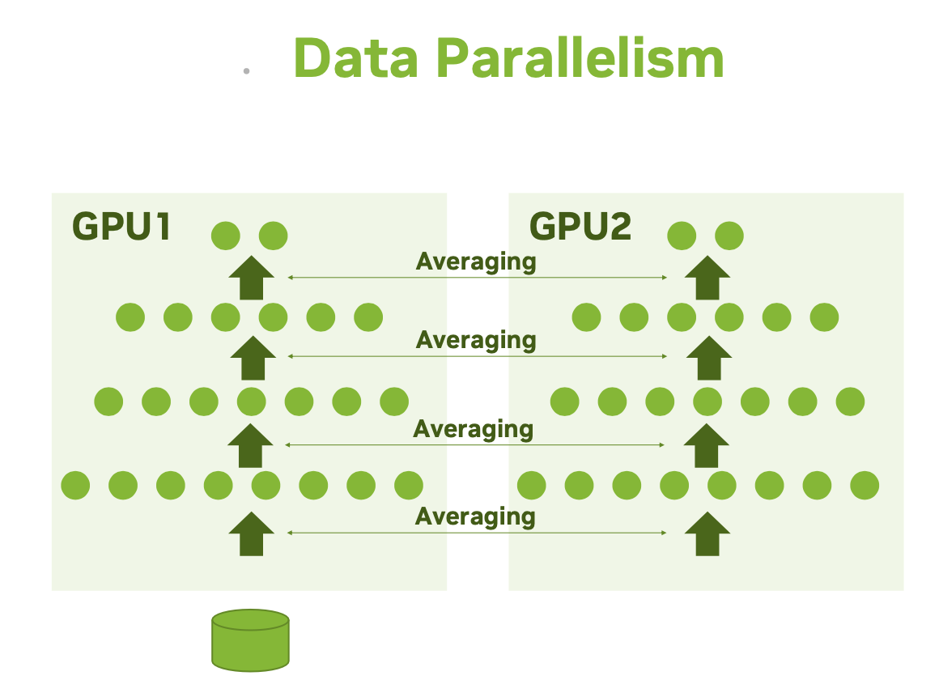
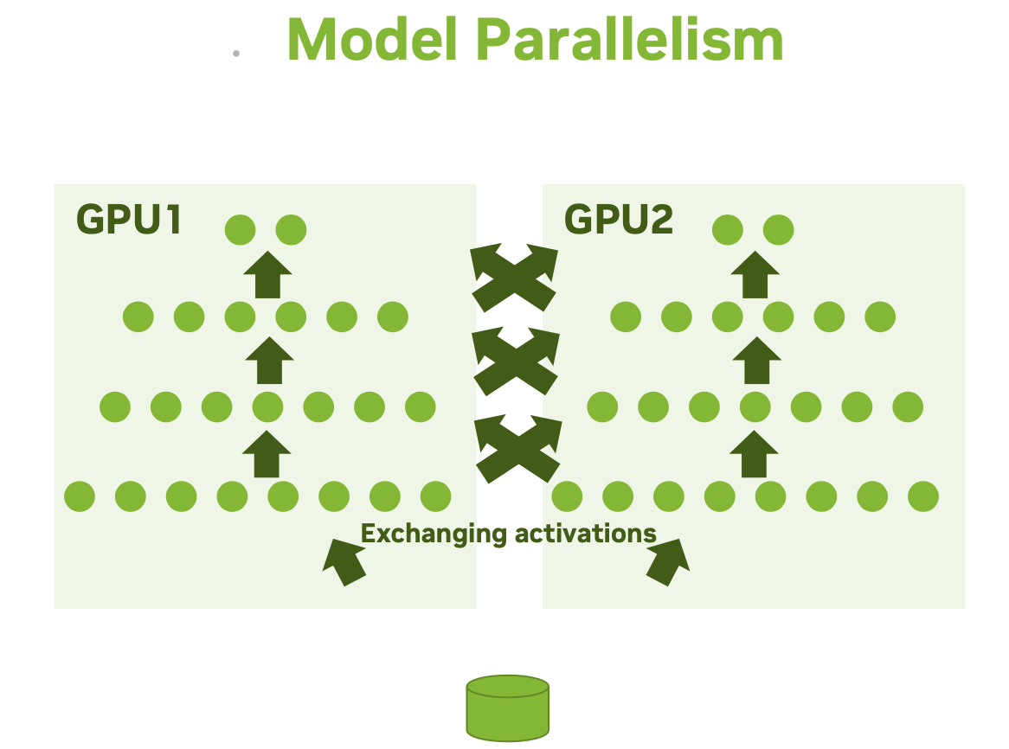
Parallelism Types
Notes:
Two ways to distribute computation across multiple devices:
Data parallelism: single model gets replicated on multiple devices. Each processes different batches of data, then they merge their results. Exists many variants,differ in how the different model replicas merge results, in whether they stay in sync at every batch or whether they are more loosely coupled, etc. The single-program, multiple data (SPMD) paradigm is used. That is, the model is copied to each of the GPUs. The input data is divided between the GPUs evenly. After the gradients have been computed they are averaged across all the GPUs. This is done in a way that all replicas have numerically identical values for the average gradients. The weights are then updated and once again they are identical by construction. The process then repeats with new mini-batches sent to the GPUs. https://www.telesens.co/wp-content/uploads/2019/04/img_5ca570946ee1c.png
Model parallelism: Different parts of a single model run on different devices, processing a single batch of data together. This works best with models that have a naturally-parallel architecture, such as models that feature multiple branches.

Slide 78
Data vs Model Parallelism
Data Parallelism
Model Parallelism
Allows to speed up training
All workers train on different data
All workers have the same copy of the model
Neural network gradients (weight changes) are exchanged
Allows for a bigger model
All workers train on the same data
Parts of the model are distributed across GPUs
Neural network activations are exchanged

Slide 79
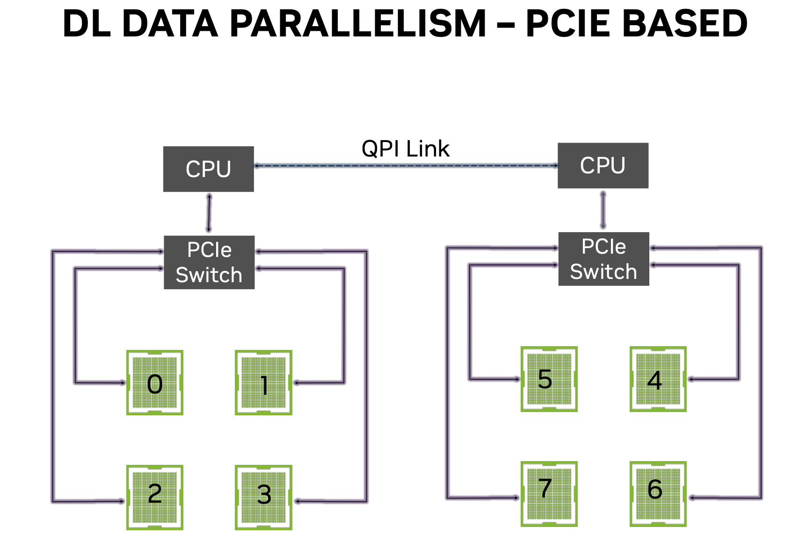
Datal loading and gradient averaging share communication resources → congestion

Slide 80
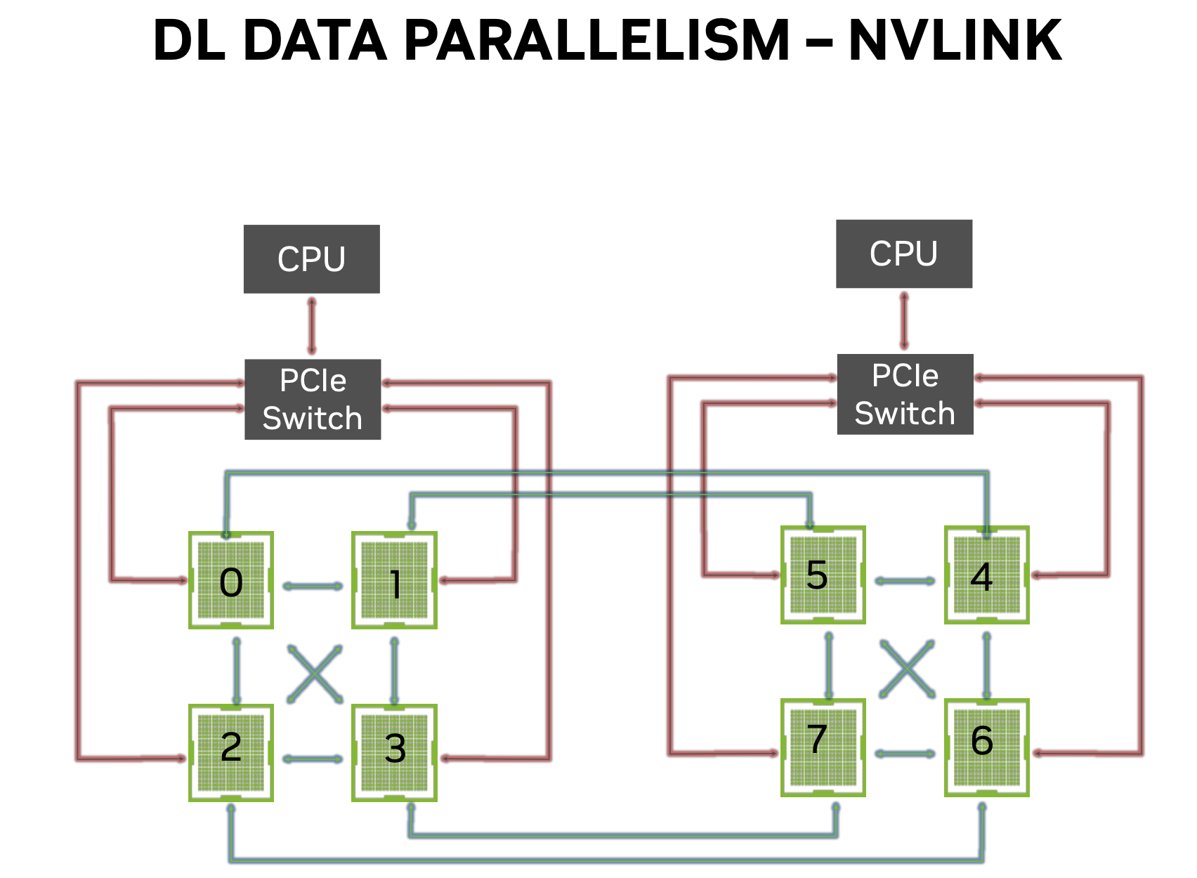
Datal loading on PCIe, gradient averaging on NVLINK → no congestion

Slide 81
Tensorflow Example: synchronous data parallelism
Notes:
This guide focuses on data parallelism, in particular synchronous data parallelism, where the different replicas of the model stay in sync after each batch they process. Synchronicity keeps the model convergence behavior identical to what you would see for single-device training.

Slide 82
Two Setups
In TF we use the tf.distribute API to train Keras models on multiple GPUs, two setups:
Single host, multi-device training. This is the most common setup for researchers and small-scale industry workflows.
Multi-worker distributed training. This is a setup for large-scale industry workflows, e.g. training high-resolution image classification models on tens of millions of images using 20-100 GPUs.
Notes:
TensorFlow will run GPU-enabled operations on the GPU by default. However, if you request more than one GPU in your Slurm script then TensorFlow will use one GPU and ignore the others unless you explicitly make the appropriate changes to your TensorFlow script

Slide 83
Single Host, Multi GPUs
Each device will run a copy of your model (called a replica).
At each step of training:
The current batch of data (called global batch) is split into e.g., 4 different sub-batches (called local batches).
Each of the 4 replicas independently processes a local batch; forward pass, backward pass, outputting the gradient of the weights.
The weight updates from local gradients are merged across the 4 replicas.
Notes:
In practice, the process of synchronously updating the weights of the model replicas is handled at the level of each individual weight variable. This is done through a mirrored variable object.

Slide 84
Coding: General Steps
Design the Model
Read in the data (recommended to use tf.data)
Create a Mirrored Strategy
Open a Strategy Scope
Train the Model
Evaluate the Model
Display the results

Slide 85
Activity: Distributed TensorFlow Program
Make sure that you can run the TF code:
Python
TF_CNN_MultiGPU.ipynb

Slide 86
Pytorch Example: Data parallel
Notes:
https://pytorch.org/tutorials/intermediate/ddp_tutorial.html

Slide 87
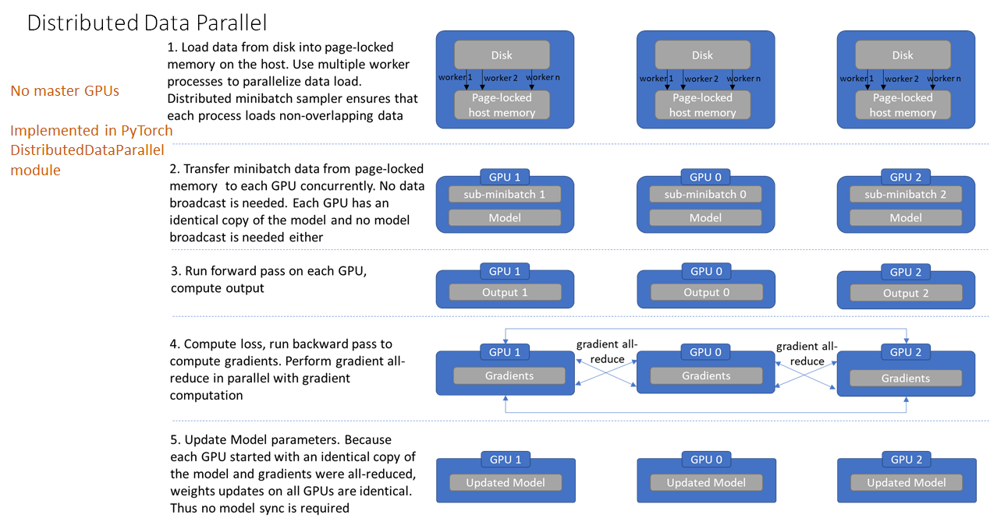
Multi-GPU, Distributed Data Parallel(DDP)
https://www.telesens.co/wp-content/uploads/2019/04/img_5ca570946ee1c.png
Notes:
Do not use DataParallel (increased overhead, runs on threads) in PyTorch for anything since it gives poor performance relative to DistributedDataParallel (runs on processes).
model parallel: https://pytorch.org/tutorials/intermediate/model_parallel_tutorial.html
https://www.youtube.com/watch?v=TibQO_xv1zc
Distributed Data Parallel video in pytorch
DDP is only applied when training, no effect during validation or evaluation
DataParallel is very easy to use and handles everything for you, but not optimized
DDP involves more coding and adjustments, but more code optimized and hence significant speedup, more salable to multiple machines and flexible

Slide 88
Coding: General Steps
Design the Model
Set up the Ranks
Read in the Data
Train the Model
Evaluate the Model

Slide 89
Activity: Distributed PT Program
Make sure that you can run the PT code:
Python
PT_CNN_MultiGPU.py
PT_CNN_MultiGPU.slurm

Slide 90
Pytorch Lightning Example: Data parallel
Notes:
https://pytorch.org/tutorials/intermediate/ddp_tutorial.html

Slide 91
PT Lightning
PyTorch Lightning wraps PyTorch to provide easy, distributed training done in your choice of numerical precision.
To convert from PT to PTL:
Restructure the code by moving the network definition, optimizer and other code to a subclass of L.LightningModule.
Remove .cuda() and .to() calls since Lightning code is hardware agnostic
Notes:
Once these changes have been made one can simply choose how many nodes or GPUs to use and Lightning will take care of the rest. One can also use different numerical precisions (fp16, bf16). There is tensorboard support and model-parallel training.

Slide 92
Activity: Distributed PT-Lightning Program
Make sure that you can run the PTL code:
Python
PTL_multiGPU.slurm
PTL_multiGPU.py

Slide 93
Remarks
Optimize single-node/single-GPU performance
Using performance analysis tools
Tuning and optimizing data pipeline
Make effective use of the hardware (e.g. mixed precision)
Before running on multiple nodes, make sure the job can scale well to 8 GPUs on a single node. Never do one GPU per node for multinode jobs.
Use multiple CPU cores for data loading.
For hyperparameter tuning consider using a job array. This will allow you to run multiple jobs with one sbatch command.
Notes:
You will likely want the code loading data to look like this:
train_dataset = datasets['train'].map(preprocess_data, num_parallel_calls=tf.data.AUTOTUNE) \ .cache() \ .shuffle(SHUFFLE_SIZE) \ .batch(BATCH_SIZE) \ .prefetch(tf.data.AUTOTUNE)

Slide 94
Questions?

Slide 95
Need more help?
Office Hours via Zoom
Tuesdays: 3 pm - 5 pm
Thursdays: 10 am - noon
Zoom Links are available at https://www.rc.virginia.edu/support/#office-hours
Website:
https://rc.virginia.edu

